Slide 1
Drug Discovery & Development

Slide 2
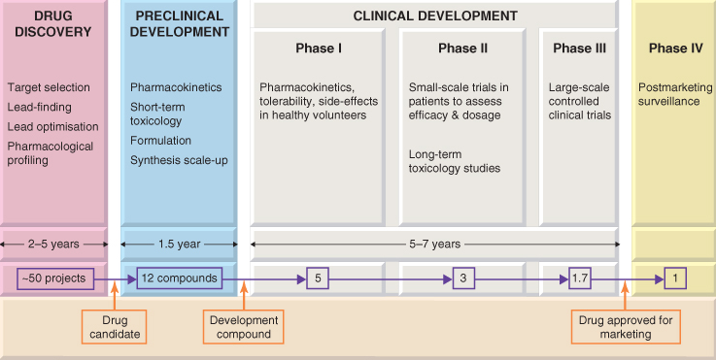

Slide 3
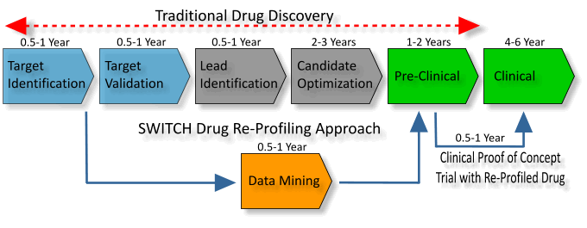

Slide 4
Discovery
Typically, researchers discover new drugs through:
New insights into a disease process that allow researchers to design a product to stop or reverse the effects of the disease
Many tests of molecular compounds to find possible beneficial effects against any of a large number of diseases
Existing treatments that have unanticipated effects
New technologies, such as those that provide new ways to target medical products to specific sites within the body or to manipulate genetic material
At this stage in the process, thousands of compounds may be potential candidates for development as a medical treatment. After early testing, however, only a small number of compounds look promising and call for further study.

Slide 5
Drug Discovery & Development
Components
Drug discovery
molecules are chosen
on the basis of their
pharmacological properties
Preclinical
Development
non-human studies
Clinical
Development
efficacy,
side-effects
and potential dangers
in volunteers and patients
  These phases do not necessarily follow in strict succession but generally overlap

Slide 6
Drug Discovery & Development
The process can be divided into three main components, namely:
  Drug discovery, during which candidate molecules are chosen on the basis of their pharmacological properties
  Preclinical development, during which a wide range of non-human studies (E.G. Toxicity testing, pharmacokinetic analysis, formulation, etc.) are performed
  Clinical development, during which the selected compound is tested for efficacy, side-effects and potential dangers in volunteers and patients.
These phases do not necessarily follow in strict succession but generally overlap

Slide 7
Drug Discovery Phase: Lead finding
First step: target identification
When the biochemical target has been decided: feasibility of the project is evaluated
Next step: find lead compounds
The human form of the target protein is cloned
  Assay system developed allowing the functional activity of the target protein to be measured

Slide 8
Compound Libraries
Large companies maintain a growing collection of a million or more synthetic compounds, which are routinely screened whenever a new assay is set up
Earlier: Compounds were generally synthesised and purified one by one, often taking a week or more for each
Currently: Use of combinatorial chemistry, which allows families of several hundreds or thousands of related compounds to be made simultaneously

Slide 9
Compound Libraries
By coupling high-speed chemistry to high-throughput assay systems, the time taken over the initial lead-finding stage of projects has been reduced to a few months
Gives results in the form of lead compounds that have the appropriate pharmacological activity and are amenable to further chemical modification
Building and maintaining huge compound libraries is, however, a costly business and even the largest practicable compound collection represents only a minute fraction of the number of 'drug-like' that exists in theory-estimated at about 10⁶⁰

Slide 10
Lead Optimisation
Lead compounds found by random screening → Lead Optimisation
Aim:
  to increase the potency of the compound on its target
  to optimise it with respect to other properties, such as selectivity, metabolic stability, etc.
In this phase tests are applied to include a broader range of assays on different test systems including
  studies to measure the activity and time course of the compounds in vivo (where possible in animal models mimicking aspects of the clinical condition)
  checking for obvious side-effects & for oral absorption

Slide 11
Lead Optimisation:
Only about one project in four succeeds in generating a drug candidate, and it can take up to 5 years
The most common problem is that 'lead optimisation' proves to be impossible
In other cases, the compounds, though they produce the desired effects on the target molecule and have no other obvious defects, fail to produce the expected effects in animal models of the disease, implying that the target is probably not a good one

Slide 12
Preclinical Development
The aim of preclinical development is to satisfy all the requirements that have to be met before a new compound is deemed ready to be tested for the first time in humans
The work falls into four categories.
  Pharmacological testing,
  Preliminary toxicological testing,
  Pharmacokinetic testing,
  Chemical and pharmaceutical development

Slide 13
Preclinical Development
  Pharmacological testing, to check that the drug does not produce any potentially hazardous or serious unwanted effects, such as bronchoconstriction, cardiac dysrhythmias, blood pressure changes, ataxia, etc.
  Preliminary toxicological testing, to eliminate genotoxicity and to determine the maximum non-toxic dose of the drug (usually when given daily for 28 days, and tested in two species). The animals so treated are examined minutely postmortem at the end of the experiment to look for histological and biochemical evidence of tissue damage.

Slide 14
Preclinical Development
  Pharmacokinetic testing, including studies on the absorption, metabolism, distribution and elimination (ADME studies) in laboratory animals.
  Chemical and pharmaceutical development, to assess the feasibility of large-scale synthesis and purification, the stability of the compound under various conditions, and to develop a formulation suitable for clinical studies.

Slide 15
GLP
Much of the work of preclinical development, especially that relating to safety issues, is done under a formal code, known as Good Laboratory Practice (GLP), which covers such aspects as record-keeping procedures, data analysis, instrument calibration, staff training, etc.
The aim of GLP is to eliminate human error as far as possible, and to ensure the reliability of the data submitted to the regulatory authority
Laboratories are regularly monitored for compliance to GLP standards
GLP standards are usually adopted after projects get beyond the discovery phase
Roughly half of the compounds fail during the preclinical development phase
For the rest, a detailed dossier is prepared for submission to the regulatory authority (Food and Drug Administration), whose permission is required to proceed with studies in humans
The regulatory authority may refuse permission or require further work to be done before giving approval

Slide 16
Screening tests
Tests on isolated tissues
Tests on animal models of human disease
General observation test
Confirmatory tests and analogus activities
MOA
Systemic pharmacology
Quantitative tests
Pharmacokinetics
Toxicity tests

Slide 17
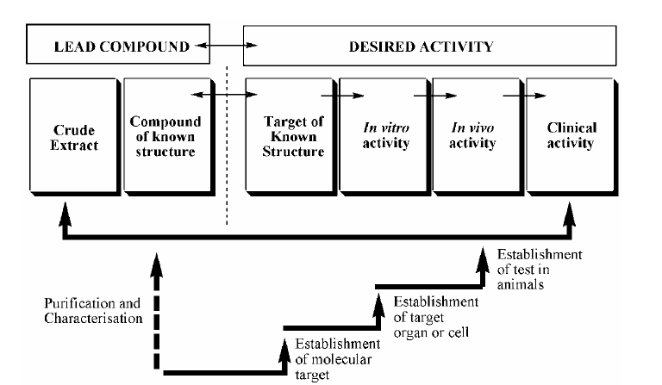

Slide 18
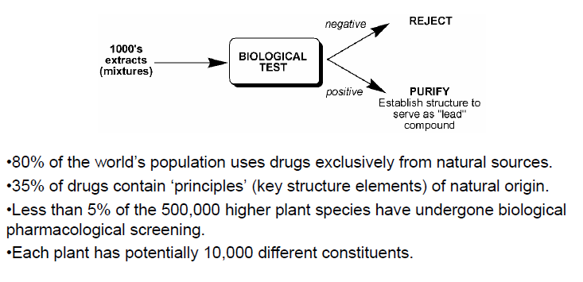

Slide 19
History: 1906 Pure Food and Drug Act/ The Biologics Control Act
In 1901, thirteen children in St. Louis died after receiving diphtheria antitoxin contaminated with tetanus spores.
This tragedy spurred Congress into passing the Biologics Control Act.
Between 1903 and 1907 standards were established and licenses issued to pharmaceutical firms for making vaccines
  Prevented mislabeling of drugs and adulteration of drugs
    BUT
  NO requirement for proof of safety/efficacy

Slide 20
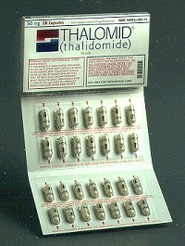

Thalidomide – the sleeping pill

Slide 21
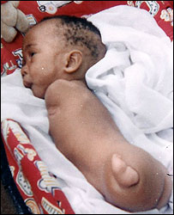
Effect = catastrophic deformations of the baby– best seen as limb abnormalities

Slide 22
Why did this happen?
Simple - the drug was not trialled or tested for this use on pregnant women

Slide 23

History: Thalidomide disaster
Thalidomide (sedative/antiemetic) disaster: malformed limbs along with other birth defects reported in Lancet in 1961
Drug was never approved in the US for morning sickness because reports of fetal malformations were quickly picked up by the press and communicated worldwide

Slide 24
Thalidomide (sedative/antiemetic) disaster: malformed limbs along with other birth defects reported in Lancet in 1961
Drug was never approved in the US for morning sickness because reports of fetal malformations were quickly picked up by the press and communicated worldwide

Slide 25
History
1906 Pure Food and Drug Act: Tetanus: contaminated diptheria antitoxin leading to deaths in children
  Required licensing of manufacturers and distributers
  Prevented mislabeling of drugs and adulteration of drugs
  NO requirement for proof of safety/efficacy.
Next major disaster:
  Elixir of sulfanilamide used to treat gonorrhea and pneumococcal infections was newly introduced in a more flavorful dosage using a solvent which was the antifreeze diethylene glycol.
  > 100 deaths
  Only charge against the company was that the “elixir” contained no alcohol.
1938 Food, Drug and Cosmetic Act: requirement for collection of clinical safety data on and submission of such data to the FDA prior to approval.
No postmarketing safety reporting requirements.

Slide 26
Kefauver-Harris Amendment (1962)
A result of the thalidomide disaster (phocomelia in newborns).
Extensive preclinical testing, submission of such data to FDA (IND) before clinical testing could begin.
Three explicit phases of clinical testing were defined. Proof of efficacy was required.
Also mandated that pharmaceutical manufacturers having an NDA must report AEs to the FDA.

Slide 27



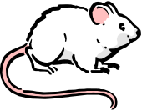
The Drug Development Process
Drug Discovery
Serendipity
Targeted therapeutic approach
Promising basic research
Interesting side effect
Natural compound screening
Where?
academic, government, corporate
$500 – 700 Million, 5 – 12 years
Funding: Venture Capital, Grant Support, Private Funding, Corporate Development
Funding: Venture Capital, Industry/Corporate, Government
Clinical Development
IND / CTA
Pre-Clinical Exploratory Development
NDA License
Lab Development
Efficacy testing -
in vitro and
animal models
Identification
Of Lead
Compounds
Synthesis &
Purification
Assay Development
Initial Formulation
Preparation of
IND Submission
& Clinical
Development Plan
Phase I
Phase II
Phase III
Phase IV
GLP / GMP strategy
PK
Safety
Safety
Dose Ranging
Preliminary efficacy
Safety
Efficacy
Development
of Product Label
Post Marketing
GCP strategy
Pharmacological Screening
Animal Studies:
Pharmacodynamic and Pharmacokinetic
Toxicity: Acute, Sub-acute/sub-chronic, Chronic, Carcinogenicity, Reproductive, Genotoxicity, Toxicokinetics
Clinical Development: to decide what studies to do ask What will the optimum drug label/product monograph be?

Slide 28
Clinical Development
Non-clinical development work continues throughout the clinical trials period, when much more data, particularly in relation to long-term toxicity in animals, has to be generated
If a drug is intended for long-term use in the clinic, the animal toxicology studies may have to be extended for up to 2 years and may include time-consuming studies for possible effects on fertility and fetal development
Failure of a compound at this stage is very costly, and considerable efforts are made to eliminate potentially toxic compounds much earlier in the drug discovery process by the use of in vitro, or even 'in silico', methods
Clinical development proceeds through four distinct phases – Phase I -IV

Slide 29
Phase 0
A recent designation for exploratory, first-in-human trials.
Designed to expedite the development of promising therapeutic agents by establishing early on whether the agent behaves in human subjects as was anticipated from preclinical studies.
Phase 0 studies help researchers find out whether the drugs do what they are expected to do. If there are problems with the way the drug is absorbed or acts in the body, this should become clear very quickly in a phase 0 clinical trial. This process may help avoid the delay and expense of finding out years later in phase II or even phase III clinical trials that the drug doesn’t act as expected to based on lab studies.

Slide 30
Even though phase 0 studies are done in humans, this type of study isn’t like the other phases of clinical trials. The purpose of this phase is to help speed up and streamline the drug approval process.
Phase 0 studies are exploratory studies that often use only a few small doses of a new drug in a few patients. They test to find out whether the drug reaches the tumor, how the drug acts in the human body, and how cancer cells in the human body respond to the drug. The patients in these studies might need extra biopsies, scans, and blood samples as part of the study process.
The biggest difference between phase 0 and the later phases of clinical trials is that there’s no chance the volunteer will benefit by taking part in a phase 0 trial – the benefit will be for other people in the future. Because drug doses are low, there’s also less risk to the patient in phase 0 studies compared to phase I studies.
Phase 0 studies help researchers find out whether the drugs do what they are expected to do. If there are problems with the way the drug is absorbed or acts in the body, this should become clear very quickly in a phase 0 clinical trial. This process may help avoid the delay and expense of finding out years later in phase II or even phase III clinical trials that the drug doesn’t act as expected to based on lab studies.
Phase 0 studies are not yet being used widely, and there are some drugs for which they wouldn’t be helpful. Phase 0 studies are very small, often with fewer than 15 people, and the drug is given only for a short time. They’re not a required part of testing a new drug.

Slide 31
Phase I: Human pharmacology & safety
Phase 1 trials are performed on a small group (normally 20-80) of normal healthy volunteers, and their aim is to check for several factors.
Safety-Does the drug produce any potentially dangerous effects, e.g. on cardiovascular, respiratory, hepatic or renal function?
Tolerability-Does the drug produce any unpleasant symptons, e.g. headache, nausea, drowsiness?
Pharmacokinetic properties - Is the drug well absorbed? What is the time course of the plasma concentration? Is there evidence of accumulation or non-linear kinetics?
Pharmacodynamic effects may also be tested-Does a novel analgesic compound block experimentally induced pain in humans? How does the effect vary with dose?

Slide 32
There are 3 common kinds of phase I trials:
  1) Single Ascending Dose (SAD) studies - a small group of patients are given a single dose of the drug and then are monitored over a period of time. If they do not exhibit any adverse side effects, the dose is escalated and a new group of patients is given the higher dose.
  2) Multiple Ascending Dose (MAD) studies - a group of patients receives multiple low doses of the drug, while blood (and other fluids) are collected at various time points and analyzed to understand how the drug is processed within the body. The dose is subsequently escalated for further groups.
  3) Food effect - designed to investigate any differences in absorption caused by eating before the dose is given. A short trial designed to investigate any differences in absorption caused by eating pre-dose, and its effect on the pharmacokinetic profile. These studies are usually run as a crossover study, with volunteers given two identical doses of the drug on different occasions; one while fasted, and one after being fed.
80% of drugs fail the Phase I clinical trial

Slide 33
SAD studies
The SAD study follows the below steps -
Initially a small number of healthy volunteers (usually n~3 to 5) are dosed with one particular dose (x1)
If there are no adverse events and the PK data are roughly in line with predicted safe values: the dose (x2) is escalated, either within the same group or a further group of healthy subjects who are then given the higher dose (x2).
Dose escalation continues until the maximum dose was attained as per protocol unless a predefined maximum exposure is reached or unacceptable side effects were apparent.
Dose escalation proceeds according to the protocol assuming strict safety and PK criteria are met.

Slide 34
If unacceptable toxicity is observed in any of the three participants, an additional number of volunteers, are treated at the same dose
This is continued until pre-calculated pharmacokinetic safety levels are reached, or intolerable side effects start showing up (at which point the drug is said to have reached the maximum tolerated dose [MTD])

Slide 35
If an additional unacceptable toxicity is observed, then the dose escalation is terminated and that dose, or perhaps the previous dose, is considered as the maximum tolerated dose. This particular design assumes that the maximally tolerated dose occurs when approximately 1/3rd of the subjects report unacceptable toxicity. Variations to this design do exist, but most are similar ones.
Apart from the above, the dose escalation can be discontinued (or proceed more cautiously than planned) if there is evidence of a supra-proportional relationship between dose and exposure, i.e. exposures at higher dose levels becomes difficult to predict.
Usually these make the Phase 1a studies.

Slide 36
Benefits of Single Ascending dose study
Benefits of SAD studies mostly include sequential groups in a parallel design for maximum exposure or have a crossover design to provide more information on dose linearity.
Studies are usually placebo controlled to determine whether effects observed are due to the study drug or environmental conditions, and are often conducted in a single (subject) blinded manner to allow informed decision on dose escalation, with safety and PK data being available for investigator review.

Slide 37
Multiple Ascending Dose
Multiple ascending dose studies investigate the pharmacokinetics and pharmacodynamics (PK and PD) of multiple doses of the drug, looking at safety and tolerability. (in nutshell Mad studies check for safety/tolerability and PK/PD)

Slide 38
MAD study
The MAD study follows the below steps -
The dose levels and dosing intervals (i.e., time between consecutive doses) are selected based on the prediction from single dose study data (safe dose/MTD).
The dose is subsequently escalated for further groups, up to a predetermined level.
Dose levels and dosing frequency are chosen in order to achieve therapeutic drug levels within human systemic (blood) circulation which is maintained at steady state for several days to allow appropriate safety parameters to be monitored.

Slide 39
This involves enrolment of healthy volunteers or patients depending on the results from the SAD studies or can be an extension of SAD study as well.
A group of healthy volunteer/patients receive multiple low doses of the drug, while samples (of blood and other fluids) are collected at various time points and analysed to acquire information on how the drug is processed within the body.
Blood samples are collected and analysed from study participants to allow the determination of PK profiles and a better understanding of how the drug is processed by the body; with multiple dosing, a key part of the PK analysis is to identify if accumulation of the drug occurs.

Slide 40
Benefits of Multiple Ascending dose study
To reduce the costs of drug development and time to market, the designs above have more recently been combined into single flexible protocols that include adequate dosing intervals to allow for the review of safety and/or PK data prior to study progression, i.e., we can have SAD and MAD in the same study design. Sometimes it also involves assessment of food effect. Usually that is the practice being followed in clinical trials now.

Slide 41
Phase II: Therapeutic exploration and dose ranging
Phase II studies are performed on groups of patients (normally 100-300) and are designed to test for efficacy in the clinical situation, as well as extending the phase I studies to include patients as well as healthy volunteers
Often such studies will cover several distinct clinical groups (e.g. depression, anxiety states, phobias, etc.) to give an indication of the possible therapeutic indication for the new compound, and the dose required
When new drug targets are being studied, it is not until these phase II trials are completed that the team finds out whether or not the initial hypothesis was correct, and lack of the expected efficacy is a common reason for failure.

Slide 42
Phase III: Therapeutic confirmation/ comparison
Phase III studies are the definitive double-blind randomised trials, commonly performed as multicentre trials on 1000-3000 patients, aimed at comparing the new drug with commonly used alternatives
These trials are extremely costly, difficult to organise and often take years to complete, particularly if the treatment is designed to retard the progression of a chronic disease
It is not uncommon for a drug that seemed highly effective in the limited patient groups tested in phase II to look much less impressive under the more rigorous conditions of phase III trials, particularly when the requirement of the regulatory authorities is that the drug should show distinct advantages over currently available therapies

Slide 43
Phase III
Increasingly, phase III trials are being required to include a pharmacoeconomic analysis, such that not only clinical but also economic benefits of the new treatment are assessed
The whole process has to comply with an elaborate code known as Good Clinical Practice, covering every detail of the patient group, data collection methods, recording of information, statistical analysis and documentation
At the end of phase III, the drug will be submitted to the relevant regulatory authority for licensing
The dossier required for this is a massive detailed compilation of all of the preclinical and clinical data obtained
Evaluation by the regulatory authority normally takes a year or more, and further delays often arise when aspects of the submission have to be clarified or more data are required
Eventually, about two thirds of submissions gain marketing approval.

Slide 44
Phase IV: Post marketing surveillance/ studies
Phase IV studies comprise the obligatory postmarketing surveillance designed to detect any rare or long-term adverse effects resulting from the use of the drug in a clinical setting in many thousands of patients
Such events may necessitate limiting the use of the drug to particular patient groups, or even withdrawal of the drug (as recently happened when a cholesterol-lowering drug, cerivastatin, was withdrawn after a few cases of severe muscle degeneration were linked to its use)

Slide 45
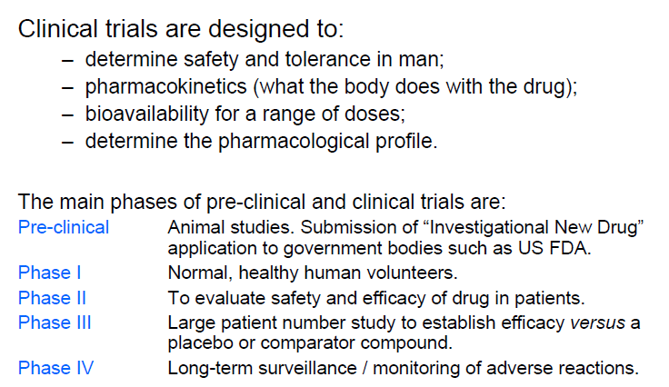

Slide 46
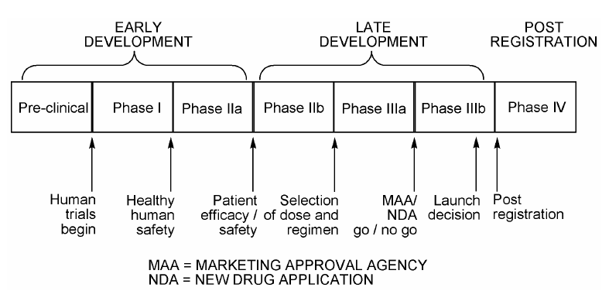
Drug development phases and decision checkpoints

Slide 47
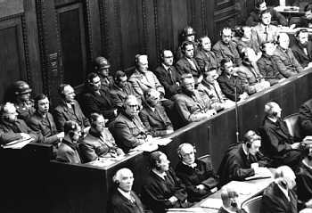
Nuremberg
During the Nuremberg
War Crimes Trials, 23
German doctors were
charged with crimes
against humanity for
“performing medical
experiments upon concentration camp inmates and other living human subjects, without their consent, in the course of which experiments the defendants committed the murders, brutalities, cruelties, tortures, atrocities, and other inhuman acts.”

Slide 48
The Nuremberg Code (1947)
As part of the verdict, the Court enumerated some rules for "Permissible Medical Experiments", now known as the “Nuremberg Code”. These rules include:
    voluntary consent
    benefits outweigh risks
    ability of the subject to terminate participation

Slide 49

Declaration of Helsinki
Recommendations Guiding Medical Doctors in Biomedical Research Involving Human Subjects
Adopted by the 18th World Medical Assembly, Helsinki, Finland, 1964 and as revised by the World Medical Assembly in Tokyo, Japan in 1975, in Venice, Italy in 1983, and in Hong Kong in 1989 and the 48th General Assembly, Somerset West, Republic of South Africa, October 1996
“Concern for the interests of the subject must always prevail over the interests of science and society.”

Slide 50
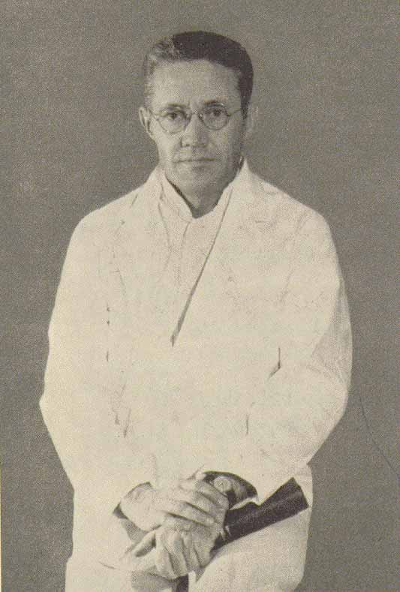
Beecher Article
“Ethics and clinical research”
Henry K. Beecher
New Engl J Med 274 (1966):1354-60
22 published medical studies presenting risk to subjects without their knowledge or approval
Published in some of the most prestigious journals and conducted at some of the most prestigious institutions

Slide 51
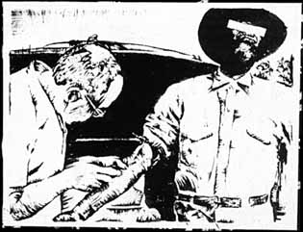
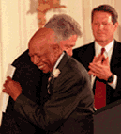
Tuskegee Syphilis Study
American medical research
project conducted by the
U.S. Public Health Service
from 1932 to 1972,
examined the natural course
of untreated syphilis in black
American men. The subjects, all impoverished
sharecroppers from Macon county,
Alabama, were unknowing participants
in the study; they were not told that they
had syphilis, nor were they offered
effective treatment.

Slide 52
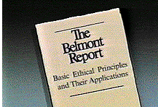
The Belmont Report
Ethical Principles and Guidelines for the Protection of Human Subjects of Research
The National Commission for the Protection of Human Subjects of Biomedical and Behavioral Research
April 18, 1979

Slide 53
The Belmont Report
Basic Ethical Principles:
Respect for Persons
  Individual autonomy
  Protection of individuals with reduced autonomy
Beneficence
  Maximize benefits and minimize harms
Justice
  Equitable distribution of research costs and benefits

Slide 54
Federal Regulations and Policy
45 CFR 46 - Basic DHHS Policy for Protection of Human Research Subjects
Originally adopted May, 1974, Revised January 13, 1981, Revised June 18, 1991
  Additional protections for vulnerable populations
  in Subparts B-D
Federal Policy for the Protection of Human Subjects - “The Common Rule” June 18, 1991
  Departments of Agriculture, Energy, Commerce, HUD, Justice, Defense, Education, Veterans Affairs, Transportation, and HHS. NSF, NASA, EPA, AID, Social Security Administration, CIA, and the Consumer Product Safety Commission.

Slide 55
Basic Protections
The regulations contain three basic protections for human subjects:
Institutional Assurances
IRB Review
Informed Consent

Slide 56
Institutional Responsibilities
Institutions bear full responsibility for all research involving human subjects covered under their Assurance
All requirements of 45 CFR 46 must be met for all federally-sponsored research
OHRP strongly encourages institutions to embrace the HHS regulations regardless of sponsorship, and to commit to this standard in their Assurance.

Slide 57
IRB Decision Matrix
BENEFICENCE
JUSTICE
Risk/Benefit Analysis
Experimental Design
Qualifications of PI
Subject selection
Inclusion/exclusion
Recruitment
RESPECT FOR PERSONS
Informed consent
Surrogate consent
Assent
Protection of subjects (especially vulnerable populations)

Slide 58
The Consent Process
Informed consent is not a single event or just a form to be signed -- rather, it is an educational process that takes place between the investigator and the prospective subject.
The basic elements of the consent process include:
full disclosure of the nature of the research and the subject's participation,
adequate comprehension on the part of the potential subjects, and
the subject's voluntary choice to participate.

Slide 59
What should you consider before joining a clinical trial
What is the purpose of the study?
Why do researchers believe the new treatment being tested may be effective?
What kinds of tests and treatments are involved?
How do the possible risks, side effects, and benefits in the study compare with my current treatment?
How long will the trial last?
Who will pay for the treatment?
How will I know that the treatment is working?
Can I leave the study after it has begun?

Slide 60
Who can participate in clinical trials?
All clinical trials have guidelines about who can participate. Exclusion / inclusion criteria help produce reliable results
Criteria based on factors such as
    Age / Gender
    Type and stage of disease
    Previous treatment
    Medical conditions

Slide 61
Benefits of Participation
Possible benefits:
Patients will receive, at a minimum, the best standard treatment (if one exists)
If the new treatment or intervention is proven to work, patients may be among the first to benefit
Patients have a chance to help others and improve patient care

Slide 62
Risks of Participation
Possible risks:
New treatments or interventions under study are not always better than, or even as good as, standard care
Even if a new treatment has benefits, it may not work for every patient
Health insurance and managed care providers do not always cover clinical trials

Slide 63
Why Do So Few People Participate in Clinical Trials?
Sometimes patients:
Don’t know about clinical trials
Don’t have access to clinical trials
May be afraid or suspicious of research
Can’t afford to participate
May not want to go against health care provider’s wishes

Slide 64
Why Do So Few People Participate in Clinical Trials?
Health care providers might:
Lack awareness of appropriate clinical trials
Be unwilling to “lose control” of a person’s care
Believe that standard therapy is best
Be concerned that clinical trials add administrative burdens

Slide 65
Randomized Trials
Participants have an equal chance to be assigned to one of two or more groups:
One gets the most widely accepted treatment (standard treatment)
The other gets the new treatment being tested, which researchers hope and have reason to believe will be better than the standard treatment

Slide 66
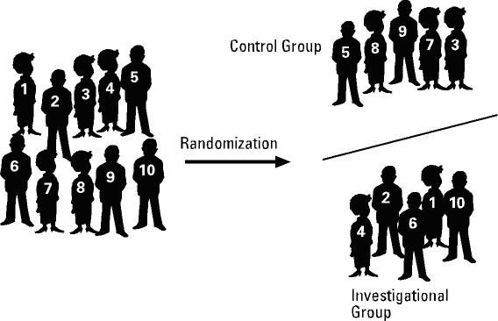
Randomization
Notes:
Explain slide.

Slide 67
Why is Randomization Important?
So all groups are as alike as possible
Provides the best way to prove the effectiveness of a new agent or intervention

Slide 68
Clinical Trial Protocol
A study plan on which all clinical trials are base (recipe or blueprint)
Strict scientific guidelines:
--Purpose of study (background about the trial)
--How many people will participate
--Who is eligible to participate
--How the study will be carried out
-- Describes trial’s design and organisation
--What information will be gathered about participants
--Endpoints
-- Ensures that trial procedures are consistently carried out

Slide 69
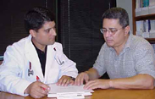
Patient Protection
There have, unfortunately, been past abuses in patient protection
Federal regulations ensure that people are told about the benefits, risks, and purpose of research before they agree to participate

Slide 70
How Are Patients’ Rights Protected?
Informed consent
Scientific review
Institutional review boards (IRBs)
Data safety and monitoring boards (DSMBs)

Slide 71
Informed Consent
Informed consent is a document designed to inform the patient of the purpose and design of a clinical study, possible side effects and benefits and if there are any other options. It should also include information on
  Voluntary participation
  Duration of trial
  Insurance and compensation
  Name and phone number of contact person
  Procedures
  Individual rights and confidentiality

Slide 72
Review boards
Scientific review
  Panel of experts
Institutional review boards (IRBs)
  Qualified people to evaluate new and ongoing trials
  All institutions that conduct clinical trials must, by law, have a IRB that approves the protocol

Slide 73
How Are Patients’ Rights Protected?
Data and safety monitoring boards:
Ensure that risks are minimized
Ensure data integrity
Stop a trial if safety concerns arise or objectives have been met

Slide 74
The Sponsor
Sponsor can be
  Pharmaceutical company
  Co-operative group (NHMRC, TROG, NSABP)
  Another Investigator
  Foundation
Responsibilities of the sponsor
  update available data
  liaise with the appropriate regulatory bodies
  communication between trial centre and sponsor
  monitoring trial at the site
  ensuring all data collected

Slide 75

The Investigator
Profile
  Adequate qualifications to conduct research in a given area
  Necessary resources
  Sound knowledge of the investigational drug and protocol
  Sound knowledge of GCP
Responsibilities
  training of staff
  ethics submission
  facilities and equipment
  resources for data collection
  informed consent
  reporting of serious adverse events

Slide 76
The Clinical Trials Nurse
Patient education
Emotional support
Management of side effects
Source documentation
  Vital signs
  Adverse events
  Protocol deviations

Slide 77
The Clinical Trial Coordinator or Data Manager
Responsible for the collection, handling, manipulation, tracking and quality of the data.
Ensure
  clinicians adhere to the protocol,
  trial patients receive the therapy dictated by the protocol,
provide support to the patients
All in accordance with Good Clinical Practice (GCP)

Slide 78
New Drug Development Process
New Drug Development Process
Initial Synthesis Animal Testing
  I N D application
  Phase I
  Phase II
  Phase III
  Phase IV
Adverse Reaction Reporting Surveys/ Sampling Testing Inspections Range 1-3 Yrs. Avg:18 Mos.
FDA Time 30 Day Safety Review Range 2-10 Yrs. Avg : 5 Yrs.
NDA Submitted NDA Approved Range 2 Mon – 7 Yrs. Avg:24 Mos.
Average of Approximately 100 Months From Initial Synthesis to Approval of NDA Treatment Use Preclinical Clinical Development NDA Review Post-Marketing

Slide 79
What is an IND…???
An IND is an Investigational New Drug application i.e. the documentation required for submission by the sponsor and clearance by the U.S. Food and Drug Administration (FDA) in order to use a drug product not previously authorized for marketing in the United States.
The IND provisions apply to new drugs, new antibiotics and new biologics.

Slide 80
When is an IND required…???
In general: An IND is required when an unapproved drug (or biologic) is used in a clinical investigation An IND is always required prior to initiation of a clinical study of an investigational new drug in the U.S. in addition an IND is require before initiation of a clinical study of the drug approved for some uses.

Slide 81
Essential Principle of an IND…!!!
IND must present adequate information to permit the FDA to evaluate the drug’s suitability for use in the proposed clinical study.
The central focus of the initial IND should be the general investigational plan and the protocol for the first proposed human study.
To assure that human subjects who participate in the proposed study will not be exposed to unreasonable and significant risk.

Slide 82
Content of an initial IND…!!!
Form FDA 1572
Table of contents
Introductory statement
General investigational plan
Investigators brochure
Clinical protocols
Chemistry, manufacturing and control data
Pharmacology and toxicology data
Previous human experience

Slide 83
The FDA Form “1572”
IND sponsors are required to obtain a signed FDA Form “1572” from each clinical investigator, containing:
  Name and address of CI
  Name and code number of any protocol(s)
  Name and address of research facility and any clinical labs
  Names and addresses of responsible institutional review board (IRB)
  Names of sub-investigators
  Signed commitment by the investigator
Introductory Statement :
Introductory Statement Description of the investigational drug
All active ingredients
Drug’s pharmacological classification
Structural formula
Route of administration
Summary of previous human experience
Formulation of the dosage forms
Objectives and planned duration of proposed clinical investigation

Slide 84
Investigational Plan :
Investigational Plan
Description of clinical studies planned for the experimental drug
Purpose for the drug or research study Indications to be studied
Types of trials to be initiated
Number of study subjects
Risks
Investigator’s Brochure 21 CFR 312.23(5)(i)-(v) :
Investigator’s Brochure 21 CFR 312.23(5)(i)-(v)
Structural formula of drug
Summary of pharmacological, toxicological, pharmacokinetic effects in animals
Safety and effectiveness
Reprints of related articles
Purpose of study
Dose/dose frequency
Method of administration
Monitoring procedures

Slide 85
Clinical Protocols
FDA reviews protocols to Ensure subjects not exposed to any unnecessary risks Phase 2 and 3 studies designs are adequate to provide the type and amount of information
Demonstrate effectiveness and safety
Considered the most important part of the IND
IND review of protocols is intended to evaluate safety of the drug
Estimate number of subjects
Describe safety
Exclusion and Inclusion
Describe dosing regimen

Slide 86
Chemistry, Manufacturing and Control Data (CMC)
Determine the adequacy of methods used to manufacture and assay investigational compound
Safety concerns
Describe drug substance
Method of preparation Reagent and solvents
Acceptable limits and analytical methods to ensure quality and purity of drug
Chemistry, Manufacturing and Control Data (CMC)

Slide 87
Pharmacology and Toxicology Data :
Pharmacology and Toxicology Data
Pharmacology and Drug Disposition Integrated Toxicology Summary
Previous Human Experience :
Previous Human Experience Marketed (foreign) or previously tested in humans
Drug Active ingredients
Must provide specific information relevant to FDA’s evaluation

Slide 88
Submission of the IND
Sponsor must submit Original Two copies
Translation required
Accurate and completed English translation for any information written in a foreign language
Must submit original foreign language document on which translation was based

Slide 89
Nature of FDA review of the initial IND
The IND contain sufficient information to allow reviewer to assess risk to human who will enter the proposed study
Humans will not be exposed to unreasonable or significant risk or illness or injury from the drug
The proposed clinical investigator is qualified training and experience to conduct the proposed study
The clinical investigators brochure in not misleading, erroneous or materially incomplete

Slide 90
Nature of FDA review of the initial IND
The IND contain sufficient information to allow reviewer to assess risk to human who will enter the proposed study
Humans will not be exposed to unreasonable or significant risk or illness or injury from the drug.
The proposed clinical investigator is qualified training and experience to conduct the proposed study.
The clinical investigators brochure in not misleading, erroneous or materially incomplete.
Clinical HoldsTo Delay/Suspend A Study :
Phase I clinical holds Subject safety concerns Phase II & III clinical holds
Concerns about safety or efficacy

Slide 91
New Drug Application (NDA)
NDA is an application submitted to the FDA for permission to market a new drug .
To obtained this permission a sponsor submits preclinical and clinical test data to NDA for analyzing the drug information, description of manufacturing procedures.

Slide 92
After NDA received by the agency, it undergoes a technical screening .
This evaluation ensures that sufficient data and information have been submitted in each area to justify “filing” the application that is FDA formal review.
At the conclusion of FDA review of an NDA, there are 3 possible action that can sent to sponsor :
  Not approvable- in this letter lists of deficiencies and explain the reason.
  Approvable- it means that the drug can be approved but minor deficiencies that can be corrected like-labeling changes and possible request commitment to do post-approval studies.
  Approval- it state that the drug is approved.
If the action taken is either an approvable or a not approvable, if not FDA provides applicant with an opportunity to meet with Agency and discuss the deficiencies.

Slide 93
Clinical Research Regulating in India- Drug Controller General of India (DCGI)
The office of DCGI runs under Central Drug Standard Control Organization.
It has main responsibility of regulating clinical trials in India.
Matters related to product approval and standards , clinical trials , introduction of new drug , and import licenses of new drugs are handled by DCGI .

Slide 94
Drugs Technical Advisory Board (DTAB)
It has technical experts and these advices the central and state governments on all technical matters arising out of the enforcement of drug control.
No rules can be made by the central government without consulting DTAB board.
Drugs Consultative Committee
It has central and state drug control official as members.
Its main function is to ensure the drug control measures and enforce them uniformly over all the states.
Genetic Engineering approval Committee (GEAC)
It is authority to approve rDNA pharmaceuticals products.
GEAC’s role is to assess the bio-safety /environmental safety aspect of the biotechnological product.

Slide 95
Commercial Aspects
The key messages are:
  high-risk business: only about 1 project in 50 makes it
  long time: about 12 years
  costs a lot of money to develop one drug
  the costs escalate rapidly as development proceeds, phase II trials and long-term toxicology studies being particularly expensive
The time factor is crucial, since the new drug has to be patented, usually at the end of the discovery phase, and the period of exclusivity (about 20 years) during which the company is free from competition in the market

Slide 96
Commercial Aspects
After 20 years, the patent expires, and other companies, which have not supported development costs, are free to make and sell the drug much more cheaply, so the revenues for the original company decrease rapidly thereafter
Reducing the development time after patenting is a major concern for all companies, but so far it has remained stubbornly fixed at around 10 years, partly because the regulatory authorities are demanding more clinical data before they will grant a licence
In practice, only about one drug in eight that goes on the market brings in enough revenue to cover its development costs
Success for the company relies on this one drug being a 'block-buster' that pays for the rest

Slide 97
http://www.npojip.org/english/no65.html
http://www.ncbi.nlm.nih.gov/pmc/articles/PMC2964774/
http://www.ncbi.nlm.nih.gov/pmc/articles/PMC2964774/table/T0001/

